Slide 1

Project Title – AIRBNB HOTEL BOOKING ANALYSIS
Oviya Kuppusamy
INTERNSHIP_17546440516895bw537820f

Slide 2

PROBLEM STATEMENT
The hospitality industry has undergone a significant transformation with the rise of online platforms facilitating short-term lodging and tourism. Leading this revolution is Airbnb, Inc., a pioneering American company that has reshaped travel accommodation through its innovative online marketplace. Established in 2008 in San Francisco, California, Airbnb provides a diverse range of lodging options, offering guests a unique and personalized experience. Unlike traditional hospitality providers, Airbnb operates on a commission-based model, facilitating transactions between hosts and guests without owning the properties listed on its platform.
This research analysis delves into the New York City Airbnb dataset to extract meaningful insights. Through rigorous data cleaning, exploratory analysis, and visualization techniques, the study aims to illuminate the dynamics of the city's lodging market. By discerning factors influencing listing availability, pricing strategies, and overall customer satisfaction, the research contributes to a deeper understanding of Airbnb’s operations in one of the world's most dynamic urban environments. These insights hold significance for stakeholders and enthusiasts seeking to navigate the evolving landscape of short-term accommodation.

Slide 3
Project Description This project is an exploratory data analysis (EDA) of the Airbnb Open Data dataset. It aims to uncover key insights into the Airbnb listings. The analysis will focus on understanding the characteristics of the properties, the distribution of listings across different geographical areas, and the factors influencing listing prices and host performance. The project addresses the following nine specific research questions: Property Types: What are the different property types listed in the dataset? Listing Distribution: Which neighborhood group has the highest number of listings? Pricing Hotspots: Which neighborhood group has the highest average prices for Airbnb listings? Construction Year & Price: Is there a relationship between the construction year of the property and its price? Top Hosts: Who are the top 10 hosts based on the calculated host listing count? Host Verification & Reviews: Are hosts with verified identities more likely to receive positive reviews? Price & Service Fee Correlation: Is there a correlation between the price of a listing and its service fee? Review Rates: What is the average review rate number (e.g., stars) for listings, and does it vary based on the neighborhood group and room type? Host Size & Availability: Are hosts with a higher calculated host listings count more likely to maintain higher availability throughout the year?

Slide 4

WHO ARE THE END USERS?
The key end-users are :
Airbnb Hosts / Prospective Hosts :
They use the data to understand market trends, set competitive pricing identify the most profitable property types , and benchmark their host performance against the top hosts.They can use the availability insights to optimize their listing management.
Property Managers and Real Estate Investors:
They are interested in market-level data to determine the best neighborhoods for investment and the expected revenue potential.They use the analysis of construction year to assess the value and price correlation of properties.
Travelers/Guests:
While less direct, the analysis of review rates provides valuable information to travelers looking for reliable, high-quality, and well-reviewed accommodations.
Local Government/Urban Planners:
They may use the insights on listing distribution and property types to understand the impact of short-term rentals on local housing markets and inform regulatory decisions.

Slide 5

Technology Used
The technologies used are :
Programming & Core Libraries (The Engine):
Python is the primary programming language
The core work is done using the Pandas library for all data loading, cleaning, manipulation, and statistical calculations
Data Visualization (The Output):
Matplotlib and Seaborn are used to create all graphical representations, including distribution plots, bar charts, and correlation visualizations .
Development Environment (The Workspace):
The project is executed within an interactive coding environment, most commonly Jupyter Notebooks, to seamlessly combine code, output, and explanatory text.

Slide 6
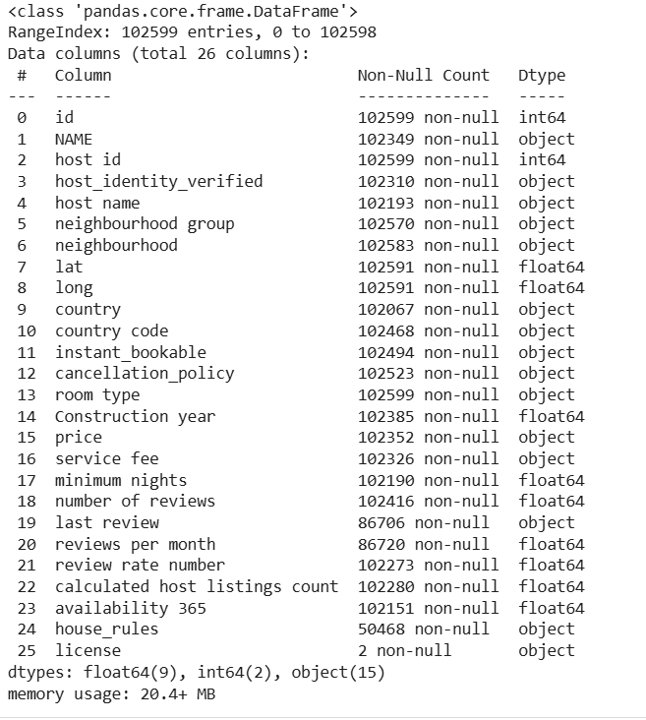
RESULTS1

Slide 7
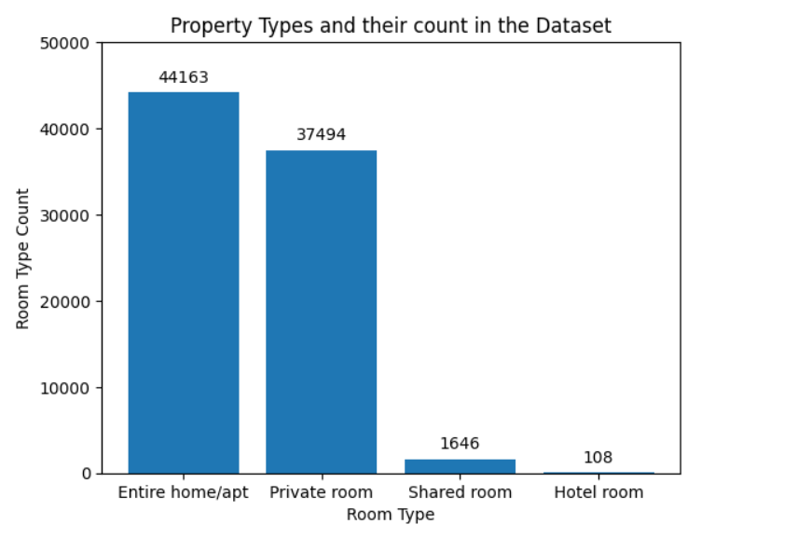
RESULTS2

Slide 8
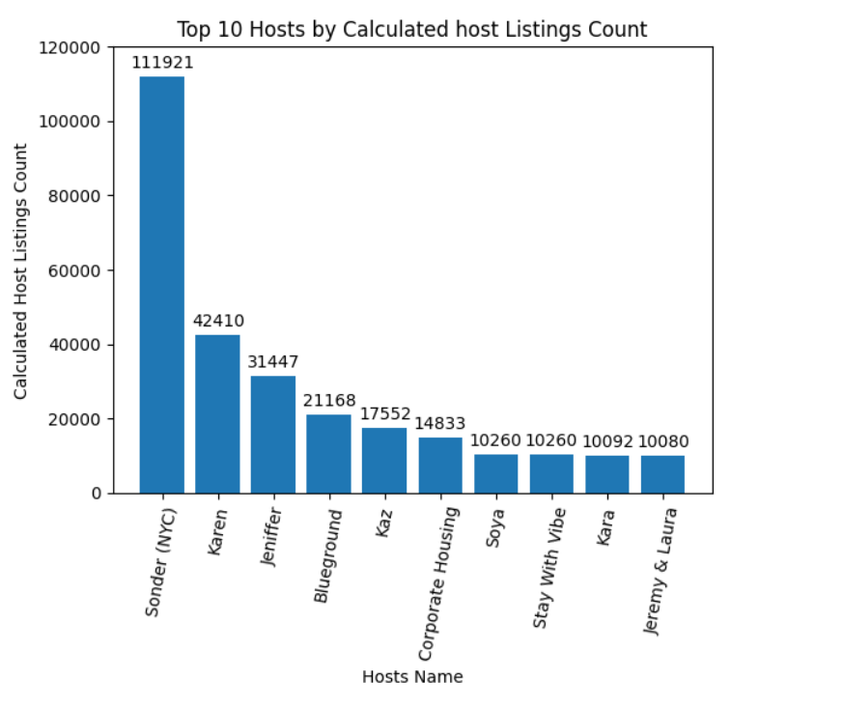
RESULTS3

Slide 9
GitHub repository
https://github.com/jothiovia-2004/VOIS_AICTE_Oct2025_Oviya-Kuppusamy.git

Slide 10
Getting started with Basics of Python Certificate

Slide 11
Data Visualization Certificate
[Paste your Certificate Here]

Slide 12
Thank you
.
.

